Slide 1
Does Syracuse Really Not Have Ticket Quotas?
By: Alexander Hartman

Slide 2
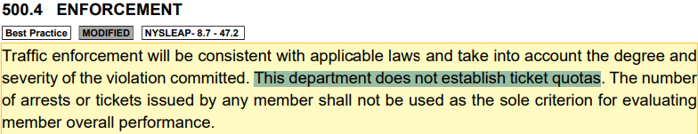
Background
It is a common belief that officers have a ticket quota they need to meet every month
The general idea: you will see more officers out and about in the later half of the month trying to give out tickets to meet their quota
However ticket quotas are actually illegal in New York, and Syracuse’s police department specifically says they do not have them.

Slide 3
Data Used
Only used parking tickets issued in 2023
Data from 2024 was incomplete

Slide 4
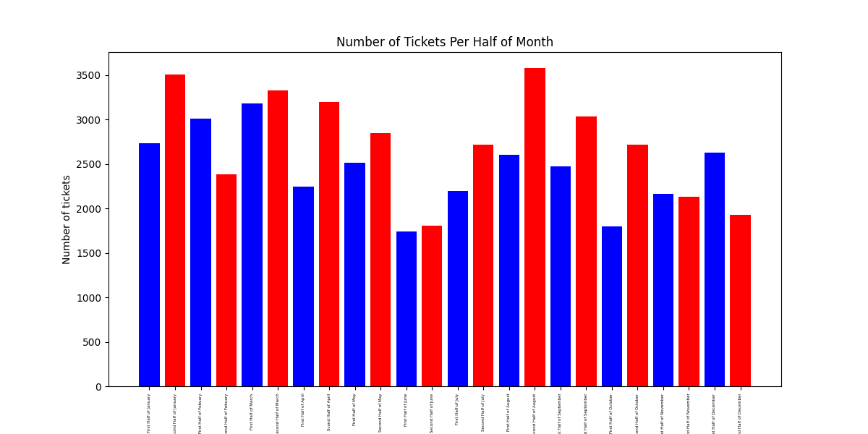
Does the data back their claim up that of no quota?
Since officer should have no incentive to ticket more at one time of the month

Slide 5
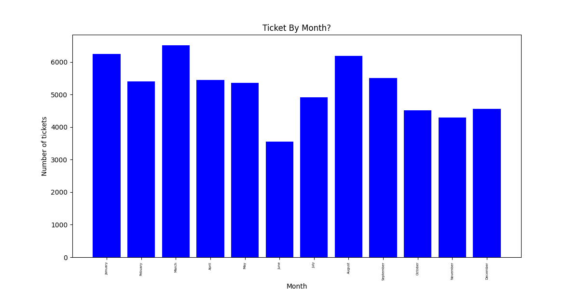
In general, there doesn’t seem to be a trend month by month

Slide 6
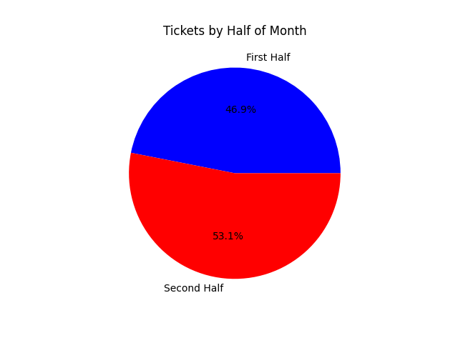
Ticket by Half of Month
Slightly more tickets in second half of months.

Slide 7
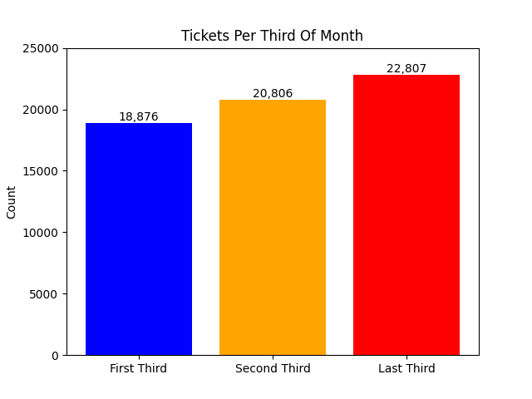

Slide 8
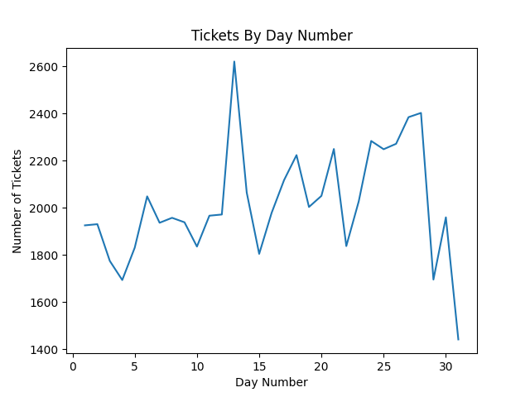
Note: The number of tickets decreases from 29+ due to February not having these days

Slide 9
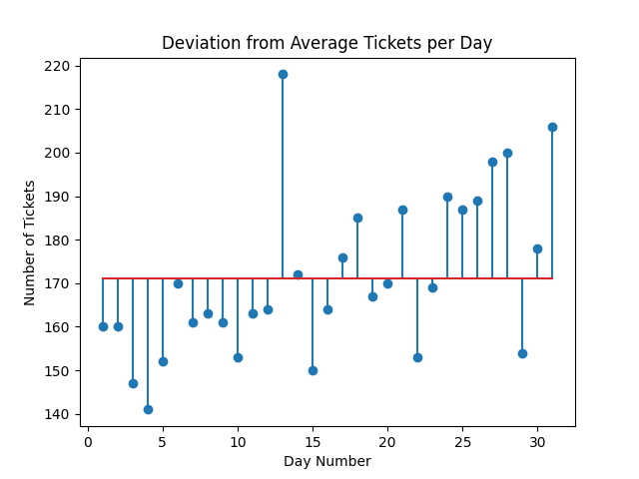
Average of Tickets Per Day Number
You can clearly see the trend up at the end of the month

Slide 10
Takeaways:
Overall there are 20.83% more tickets in the last third of the month compared to the first third
There may be other explanations:
Massive jump in second half of august when students are moving in may skew data.
Bigger holidays (Halloween, Christmas, Labor Day, Memorial Day) are in the second half of the month
Only a year of data, may be skewed by outliers

